Slide 1

APPLIED DATA SCIENCE
Ezhilarasan.b
VVCET

Slide 2

CREDIT CARD FRAUD DEDECTION
Introduction
Different analysis
Matplotlib
Read data set
Column names
Create series
Plt.plot(score ,expectancy)
#addcolor,style.....
Plot()function
Title()function show() functions
conclusion

Slide 3

INTRODUCTION
Machine learning algorithms play a crucial role identifying fraudulent transactions by analyzing patterns and anomalies in credit card data.
Commonly used machine learning algorithms for credit card fraud detection include logistic regression, decision trees, random forests, and neural networks.

Slide 4

PROBLEM DEFINITION
The problem is to develop a machine learning-based system for
real-time credit card fraud detection.
The goal is to create a solution that can accurately identify fraudulent transactions
while minimizing false positives.
This project involves data preprocessing, feature engineering, model selection, training, and
evaluation to create a robust fraud detection systems

Slide 5

What the Credit Card Fraud Detection?
Credit card fraud is the act of using another person’s credit card to make purchases or request cash advances without the cardholder’s knowledge or consent.
These criminals may obtain the card itself through physical theft, though increasingly fraudsters are leveraging digital means to steal the credit card number and accompanying personal information to make illicit transactions

Slide 6
Types of credit card fraud
Credit card fraud falls into two basic categories:
1) Card present fraud
2) Card-not-present fraud

Slide 7

DIFFERENT ANALYSIS

Slide 8

Deep Learning for Fraud Detection
Explore advanced neural network architectures like convolutional neural. networks (CNNs) and recurrent neural networks (RNNs) for more.
sophisticated feature extraction and time series analysis. You can use deep learning models, such as a neural network,
to capture complex patterns in the data.

Slide 9
from tensorflow.keras.models import Sequential from tensorflow.keras.layers import Dense model = Sequential([ Dense(128, input_dim=X_train.shape[1], activation='relu'), Dense(64, activation='relu'), Dense(1, activation='sigmoid') ]) model.compile(optimizer='adam', loss='binary_crossentropy', metrics['accuracy']) model.fit(X_train, y_train, epochs=10, batch_size=32)
PROGRAM

Slide 10

Real-time Monitoring
To detect fraud in real-time, you can set up an automated system that continuously monitors incoming transactions and applies your trained model to identify anomalies.
This Photo by Unknown author is licensed under CC BY.

Slide 11


IMPLANCED DATA HANDLNG
Credit card fraud datasets are often imbalanced, with a majority of non-fraudulent transactions. You may need to use techniques
Like oversampling, under sampling, or Synthetic Minority Over-sampling Technique (SMOTE) to handle this imbalance.
This Photo by Unknown author is licensed under CC BY.

Slide 12
from imblearn.over_sampling import SMOTE sm = SMOTE(sampling_strategy=0.5) X_resampled, y_resampled = sm.fit_resample(X_train, y_train) # Train the model with the resampled data model.fit(X_resampled, y_resampled)
PROGRAM

Slide 13
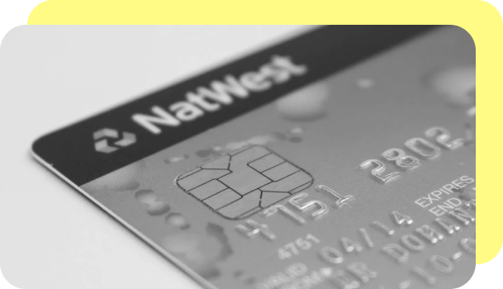
Descriptive Analytics
Data Exploration:
Initial analysis to understand
data characteristics.
Data Visualization:
Using charts to spot trends and patterns.

Slide 14
PROGRAM
# Data Exploration
legitimate_transactions.describe()
fraudulent_transactions.describe()
# Data Visualization import matplotlib.pyplot as plt plt.scatter(legitimate_transactions['amount'], legitimate_transactions['hour'],
label='Legitimate', color='green') plt.scatter(fraudulent_transactions['amount'], fraudulent_transactions['hour'], label='Fraudulent', color='red') plt.legend() plt.show()

Slide 15
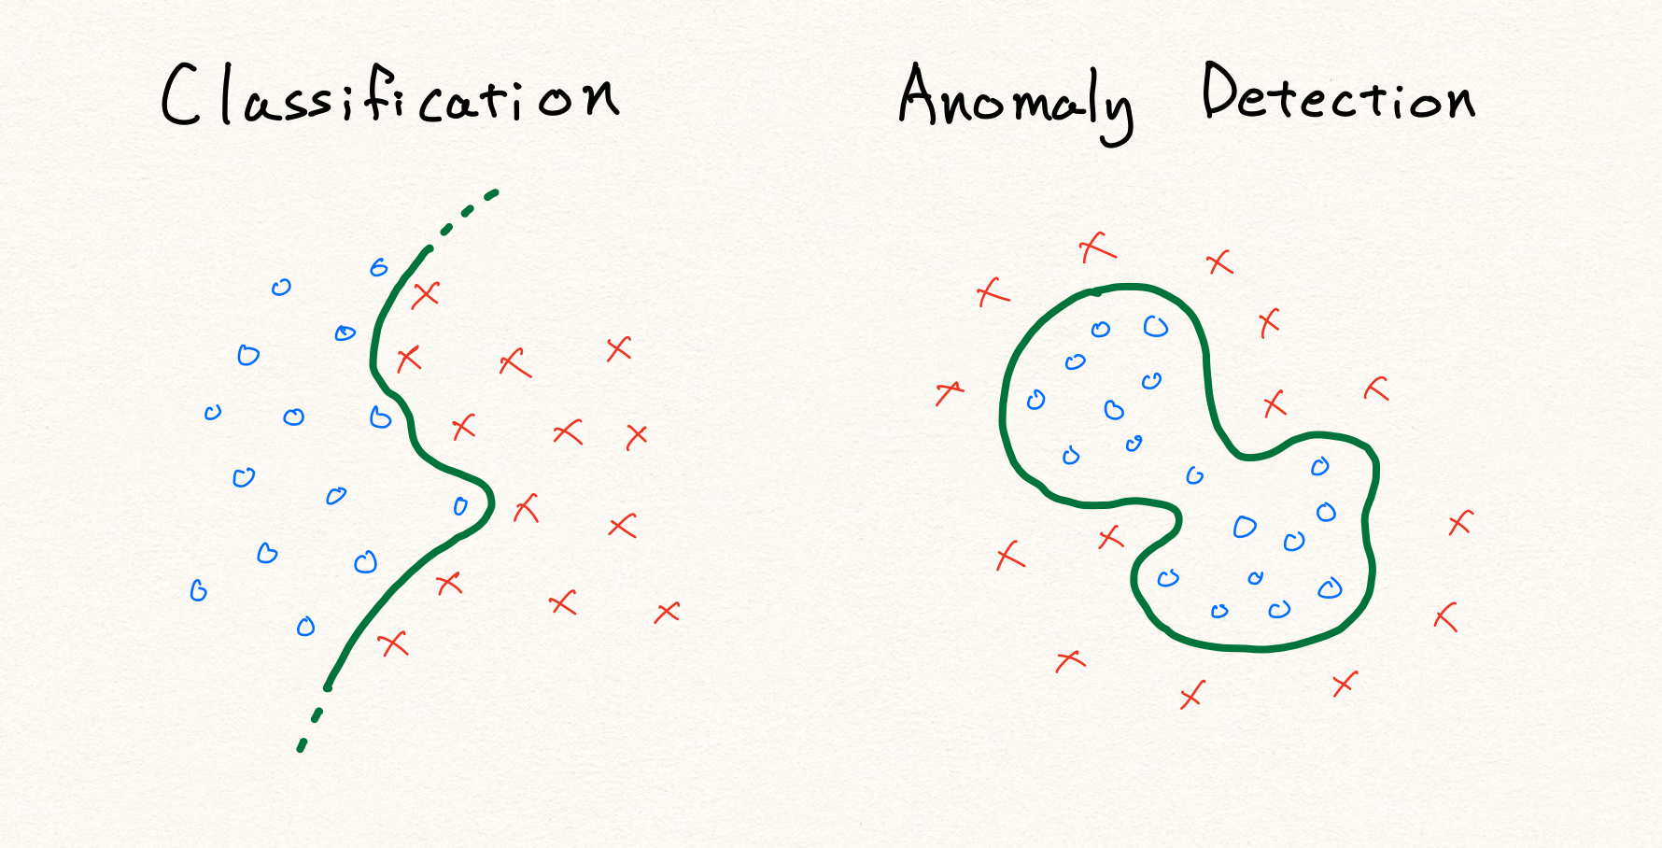
Anomaly Detection
Identifying outliers in data using Isolation Forest.
Set a contamination parameter for the expected proportion of outliers.

Slide 16

Predictive Analytics
Using logistic regression to predict fraud.
Split data into training and test sets for model evaluation.
This Photo by Unknown author is licensed under CC BY-NC.

Slide 17
Program: from sklearn.model_selection import train_test_split from sklearn.linear_model import LogisticRegression from sklearn.metrics import accuracy_score, confusion_matrix X_train, X_test, y_train, y_test = train_test_split(X, y, test_size=0.2) model = LogisticRegression() model.fit(X_train, y_train) predictions = model.predict(X_test) accuracy = accuracy_score(y_test, predictions) cm = confusion_matrix(y_test, predictions)

Slide 18

Rule-Based System
Define rules to classify transactions as legitimate or fraudulent.
Rules may be based on transaction amount, location, or other factors.
This Photo by Unknown author is licensed under CC BY-NC-ND.

Slide 19

Program: def rule_based_fraud_detection(transaction): if transaction['amount'] > 1000 and transaction['location'] not in trusted_locations: return "Fraudulent" else: return "Legitimate" result = rule_based_fraud_detection(transaction_data)

Slide 20
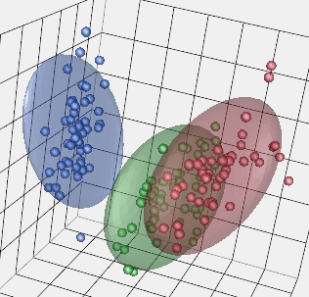
Unsupervised Learning (K-Means Clustering)
Grouping transactions into clusters.
Requires specifying the number of clusters.

Slide 21

PROGRAM
from sklearn.cluster
import KMeans kmeans = KMeans(n_clusters=2)
kmeans.fit(X) labels = kmeans.labels_

Slide 22
Deep Learning (Using TensorFlow and Keras)
Building a neural network model for fraud prediction.
Training the model using labeled data and an appropriate loss function.

Slide 23

Network Analysis:
Examining transaction networks and relationships to identify
patterns of fraud, especially in cases of organized fraud rings.

Slide 24
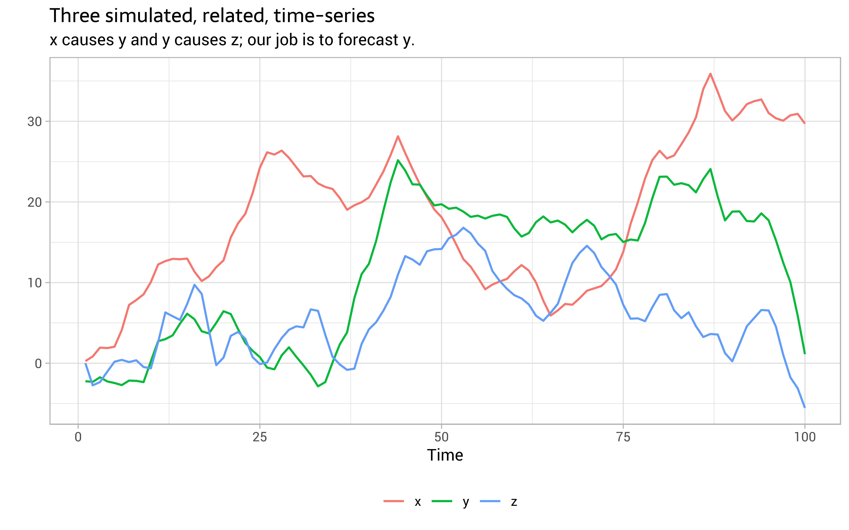
Time Series Analysis
Studying transaction time series data to detect anomalies and seasonality in fraud patterns.

Slide 25

Pandas Library
Pandas is a widely used Python library for data manipulation and analysis.
It provides functions to read, clean, and preprocess datasets.

Slide 26
Receiver Operating Characteristic (ROC) Curve
The ROC curve is a standard tool to evaluate the performance of binary classification models, like fraud detection models.
It shows the trade-off between true positive rate and false positive rate.

Slide 27

THANK YOU

